Slide 1

Databased
Notes:
Now it’s time to get into the presentation.

Slide 2
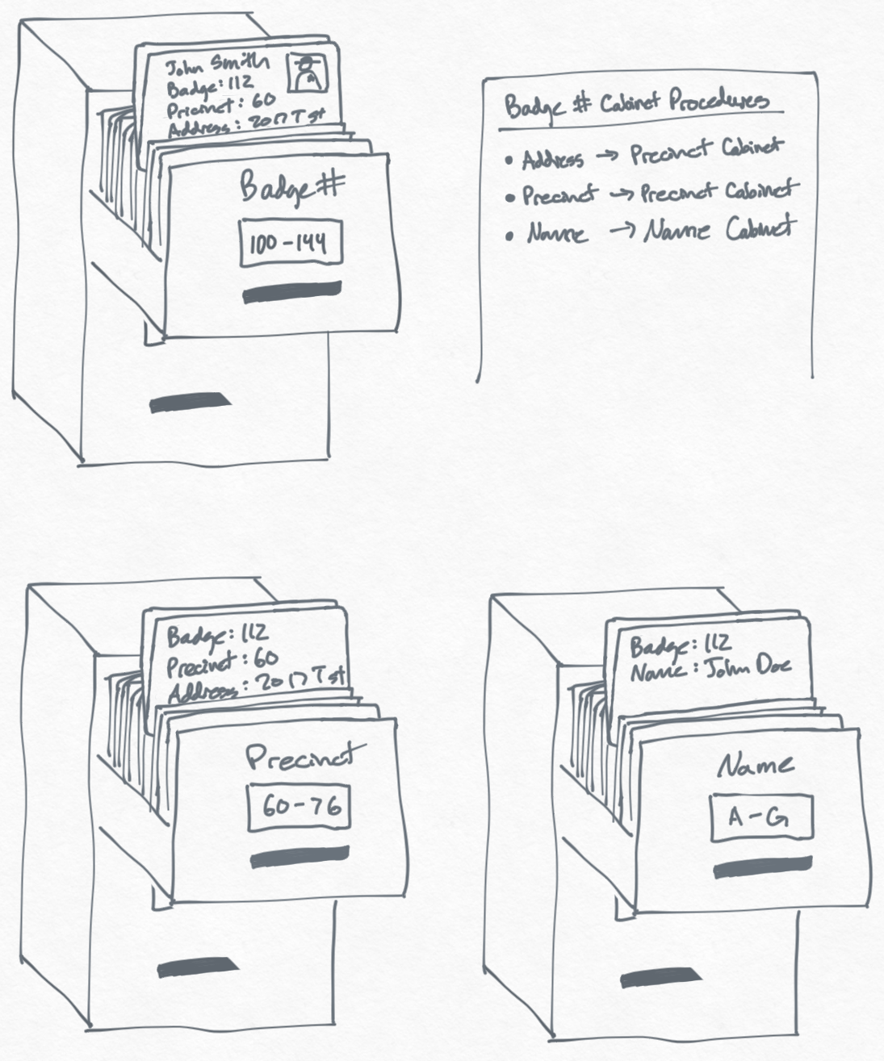
What is a database?
an organized collection of structured information, or data, typically stored electronically in a computer system
Notes:
Does anyone know what a database is?
Here’s a definition from Oracle: an organized collection of structured information, or data, typically stored electronically in a computer system.
Source: https://www.oracle.com/database/what-is-database/

Slide 3
What types of things are stored in databases?
text, numbers, dates, and more!
Facebook posts
Video game catalogs
Concert ticket sales
School records
Movies
(like IMDb)
Sports statistics
Notes:
Anyone have any idea what can be stored in a database?
Data can take many forms, like text, numbers, and dates. That can be used in a variety of fields – theoretically anything can be data.
Whether you know it or not, you have definitely interacted with databases in your daily life. These interactions aren’t usually direct, but behind the scenes, a database powers a lot of digital experiences! These are just a few examples. If you’ve bought a concert ticket, looked at your grades, logged hours on a video game – all of that stuff is stored in a database somewhere. One example is IMDb (which stands for Internet Movie Database). But how is the data actually stored?

Slide 4
Relational Databases
SQL
Title | Year | Genre | Director
Billy Madison | 1995 | Comedy | Tamra Davis
The Wedding Singer | 1998 | Comedy | Frank Coraci
Reign Over Me | 2007 | Drama | Mike Binder
Grown Ups 2 | 2013 | Comedy | Dennis Dugan
Uncut Gems | 2019 | Thriller | Josh & Benny Safdie
Data is stored in tables where each row is a record, and each column is a property
Notes:
Relational databases are one of the main ways to store data.
Relational databases look something like this. What is this? The keyword we’re looking for is “table” – this is a table of Adam Sandler movies! This is how relational databases store data.
Data is stored in tables where each row is a record, and each column is a property. In this case, each row is a movie, and there are four columns with information about that movie. But how do people interact with a relational database?

Slide 5


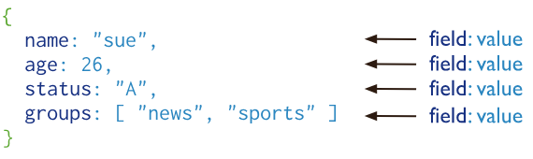
NoSQL
MongoDB is a document database designed for ease of application development and scaling.
A record in MongoDB is a document, which is a data structure composed of field and value pairs:
Notes:
MongoDB is a document database.
Basically, every record (or object) is a document. Each document has fields and values – for example, this document has a “name” of “sue”, an “age” of “26”, etc. What type of record might this be? It looks like it’s a person! MongoDB can store all types of records, and it is extremely flexible.

Slide 6


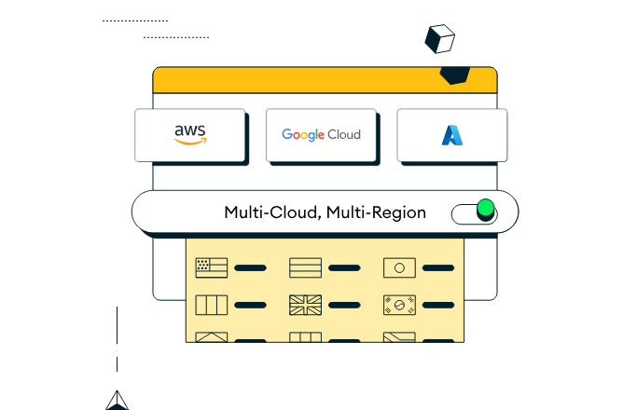
Atlas: MongoDB in the cloud
What is the cloud?
Reality
A bunch of computers
(i.e., a global network of servers)
Perception
A magic place where everything lives forever
What is MongoDB Atlas?
an integrated suite of data services centered around a cloud database designed to accelerate and simplify how you build with data – with a free option!
Notes:
One of the nicest things about MongoDB is the ability to store data in the cloud using Atlas. Does anyone know what the cloud is?
You might think it is a magical place where everything is stored (like iCloud photos or Google Drive documents).
Really, it’s just a bunch of computers – the important thing is that they are all connected.
MongoDB Atlas is a platform that allows users to use MongoDB in the cloud – and you can get started for free!
We will be diving much deeper into Atlas during the follow-along activity after the break.

Slide 7

Basic Database Operations: C.R.U.D.
Notes:
Now it’s time to get a little more specific. Anyone know the movie C.H.U.D.? Probably not. Why is that up here? Well, it’s very close to another acronym.

Slide 8

Basic Database Operations: C.R.U.D.
regardless of the approach, these operations are a fundamental aspect of almost any DB
Read
view existing records in the database
Delete
remove existing records from the database
Create
add new records to the database
Update
edit existing records in the database
many applications are built upon the foundation of these four operations!
Notes:
There is a set of basic operations that are quite important for almost any type of database: C.R.U.D.
These operations are fundamental to both SQL and NoSQL databases. So, what are they?
C stands for Create – adding data to the database.
R stands for Read – looking at data that’s already in the database.
U stands for update – taking existing data, and modifying it.
D stands for delete - getting rid of existing data.
You can do quite a bit with just these four operations – in fact, many applications are built entirely with these! Can anyone think of a time they’ve completed any of these actions in a software application?
One of the prime use cases for CRUD operations is social media. Any time you post something, or look at posts, or edit a post, or delete a post – you are performing a CRUD operation!

Slide 9
Time to make your own!

